Slide 1
Differential Response
Day 1

Slide 2

Lets get to it
Housekeeping
Note Books
2, 10 minute breaks: one in the morning and the other in the afternoon.
Lunch will be on your own and for an hour
Bathrooms are……..
Cell phones and laptops
Yours to keep
Practice Model
Differential Response policy
Need vs. Services Definitions and examples
Resources
Expanded Health and Safety Factors
Notes:
Parking lot

Slide 3
Learning Objectives
Understand Differential Response (DR)
Understand the steps of Differential Response
Understand Differential Response policy and how to apply it to DR practice
Understand the Roles and Responsibilities of DR Team
Understand the allegations Accepted for Differential Response
Understand Engagement and its role in Differential Response
Notes:
Give Pre-test
Ice Breaker Activity

Slide 4
Differential Response
A method that allows child welfare systems to respond to reports of specific allegations of child maltreatment through a family assessment. This focuses on the safety and well-being of the child and promotes permanency.
Notes:
Define -Differential Response is a system reform that enables child protective services to differentiate its response to reports of child abuse and neglect based on several factors.
DR Emphasize the importance of broadly assessing all families situations to identify and meet underlying needs.

Slide 5
The Big Picture: General Philosophy and History of DR
DR has been developed out of “system” need to respond more appropriately to the variety of child abuse and neglect reports being assessed within the child welfare system.
Including differential response in triage procedures for the appropriate referral of a child not at risk of imminent harm to a community organization or voluntary preventive service (section 106(b)(2)(B)
Volume increases lead to practice shift
Differential Response approach developed
Notes:
The trend to create DR systems developed out of these circumstances as a way to continue to shift practice towards family-centered approaches by “providing interventions that more closely match the severity of the concern being reported and by engaging families in the assessment process, which results in more balanced assessment and planning for children.
There is also a focus on providing needed services to families without substantiating the report since many communities require this in order to offer services. Even if the substantiation was not required, many families were not receiving services and were subsequently re-reported.
Some evaluators believe that DR had a positive impact in the way we related to families in child welfare and that creates positive outcome whether or not services are offered.

Slide 6
Federal Mandate and State Law
Child Abuse Prevention and Treatment Act Reauthorization Act of 2010 Public Law 111-320 issuance date 2-15-2011
Including differential response in triage procedures for the appropriate referral of a child not at risk of imminent harm to a community organization or voluntary preventive service (section 106(b)(2)(B)

Slide 7
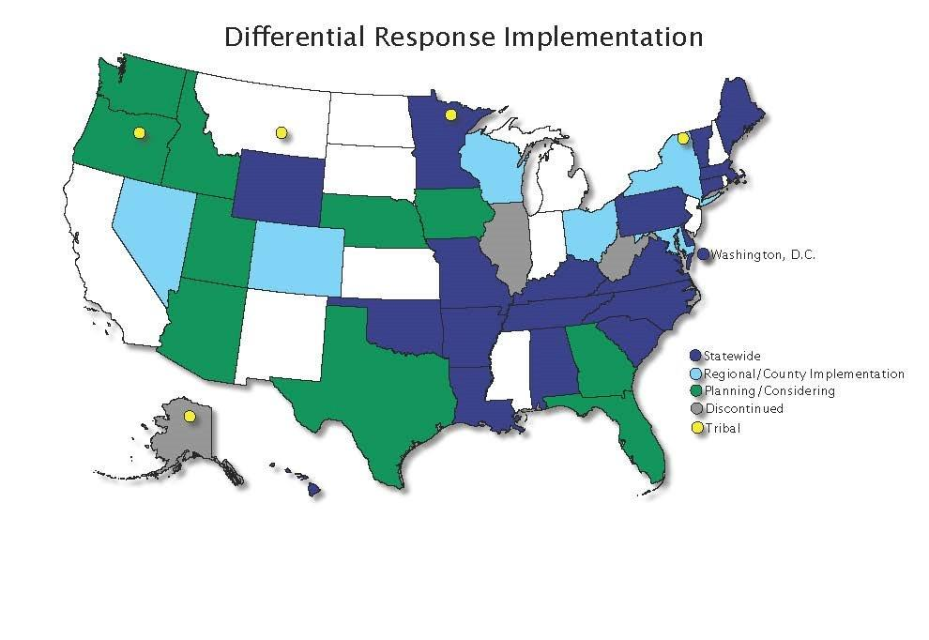
Where is DR implemented…

Slide 8
Differential Response
Focuses less on investigative fact finding and more on family engagement while assessing and ensuring child safety
Seeks safety through family engagement and collaborative partnerships
Allows and encourages agencies to provide services without formal determination of abuse or neglect
Notes:
No formal determinations-workers must assess safety of the children – assessment starts on day one and continues throughout intervention - staff must learn to connect clients to services and supports in the community
Collaborative partnerships-will be those people and businesses you identified on your action plans. Who in the community will we be asking for help? Civic groups sororities fraternities youth groups church organizations

Slide 9
Investigation Vs. Family Assessment
Investigations require gathering of forensic evidence and formal determinations as to whether the abuse/neglect occurred.
Family assessments are non-adversarial and non-accusatory responses and there is no formal finding of substantiated or unsubstantiated. The family is treated as a whole and does not identify a perpetrator or victim.
The health and safety checklist is completed. Safety of the children is paramount.
DR is family driven
Notes:
Describe DR vs Investigation explain their differences
Stress importance of safety issues.
ACTIVITY: USING 14 SAFETY FACTORS- working in groups answer questions on worksheet- report out responses and get group feedback

Slide 10
Some AR Practice Model Goals and Principles as Related to Best Practice
Safely keep children with their families
Enhance well-being in all of our practice with families
Safety for children is achieved through positive protective relationships with caring family and community members
Behavior change and the work of change is a part of our daily challenge
Meaningful decisions require close family participation in decision making

Slide 11
Continued
Strengths of families and supporting these strengths contribute to life-long permanent relationships for children
Families’ success depends on community involvement and shared problem solving
Practice with families is interrelated at every step of the casework process
Sustainable success with families is the work of a team

Slide 12
Activity
The Difference Between Family Driven and System Driven Practice
Notes:
Break – Flip chart for Family Driven and System Driven - Have two flip charts one with family driven and one with system driven on it. Have the participants state what practices we now use that are system and family driven. We will add to these flip charts throughout the day.

Slide 13
The Difference Between Family Driven and System Driven Practice
Family Driven
System Driven
Expectation of collaboration and engagement
Families are the experts
Builds safety around children
Solution focused
Focus on the holistic view of the family
Expectation of compliance
The system/worker is the expert
Protect children from abuser/perpetrator
Problem focused
Focus on what brought the family into the system

Slide 14
Values of Differential Response
Family engagement
Strengths based perspective
Thinking outside of the box to involve family input
Allow the family to lead with things they think they need to work on
Ask the family to identify sources of support for them
Ensure that all service needs are addressed even if they are outside the scope of the original allegation
Notes:
values

Slide 15
Commonalities of Traditional and Differential Response
Both are needed responses to child abuse and neglect reports
Both aim to achieve the three major child welfare outcomes: child safety, promotion of permanency and attunement of child well-being
Both recognize agency’s authority to make decisions about placement and court involvement
Both contribute to creating system flexibility so CPS can respond to family’s changing circumstances, needs and desires
Notes:
Ask participants to share aloud any other similarities they can identify between DR and TR.
Engagement skills are necessary in both approaches but they are essential in the DR process
Through this training you will gain skills to help you with the engagement process.

Slide 16
Process of Differential Response
Hot Line Call
Differential Response
Formal Determination
Investigation
Refer back to Investigation
Provide Services to the Family through DR Case
Close DR Case with no Services
Notes:
Explain the referral to closure process. What happens with each stage and time frames. The Hotline will operate as normal and will screen the calls for either DR or investigation. If an investigation comes in and the investigation supervisor feels it should have been a DR referral they can email the hotline supervisors. They will review and decide if the investigation should go to DR at that time.

Slide 17
Hotline
The hotline will screen referrals as normal
The hotline staff will determine whether the criteria from the reporter meets the DR requirements
The information will be accepted and placed in the DR box for review.
The DR supervisor will then review and determine if the referral meets all criteria for DR, if it does, then it will be assigned to a DR worker.
In the event that the referral doesn’t meet DR criteria the DR supervisor will request from the Central office DR unit a switch the referral to investigation.
.

Slide 18
Allegations Accepted for the DR Pathway and Exclusions
Inadequate Supervision-excludes reports involving a child or children under the age of 5, or a child older than 5 years of age with a physical or mental disability which limits his or her skills in the areas of communication, self-care, and self-direction.
Educational Neglect-excludes reports involving a child that was never enrolled in an educational program
Environmental Neglect-exclusions involve children under the age of 3

Slide 19
Continued
Lock Out-excluding any child under the age of 10
Medical Neglect-excluding any child under the age of 13 or a child with a severe medical condition that could become serious enough to cause long-term harm to the child if untreated
Inadequate Food
Inadequate Clothing
Inadequate Shelter

Slide 20
Continued
Human Bites
Sprains/dislocations
Striking a child age seven or older on the face
Striking a child with a closed fist
Throwing a child
  Excludes events that happened less than one year ago; and or
  The caller to the hotline can verify injury (physical signs, medical, date photograph)
All of these reports will be assessed by the hotline and any can be assigned to the investigative pathway if the hotline or DR Coordinator has cause for concern for the health and safety of the children.

Slide 21
Role and Responsibilities of DR Team
Partner with Families
Work as a Team
Communicate with local office
Know community resources
Notes:
-Allow the family to lead the discussions and decide what issues or problems they want to work on.
-Work as a team with the family. You are both in this together and need to help each other for better outcomes.
-Ensure that all members of the DR team are communicating with each other to ensure best service delivery.
-Understand all community resources that are available to you. Foster new and old relationships with these resources to ensure that you have a well rounded realm of services to reach all needs.

Slide 22
DRT COORDINATOR\UNIT
Provide technical support for the DR Teams
Managing online reports in relation to time frames of DR assessments
Review closed DR referrals
Shadow DR workers
Notes:
-if the DR team identify a safety factor or determine that the referral doesn’t meet DR criteria, the Coordinator and specialist will switch referral to investigation.
-We will provide technical support to the DR teams. The specialists and PA’s will need to conference with their supervisors about any and all DR assessments. If the team is unable to come to a conclusion or needs any type of support I will be available to help. I will also provide on site visits to the county office to meet with the teams.

Slide 23
DRT Supervisor
Screen out reports from hotline and assigned to DR staff
Supervisor will assign each report within 2 hours of receipt
Conference with DRT Specialist within 24 hours to determine whether report should be transferred to investigation
Conference with DRT Specialist regarding the facts and status of the DR case
Review DR case closures and requests for extensions
Review and approve appropriateness of case referrals, documentations, and extensions
Notes:
Explain role of the DR supervisor

Slide 24
DRT Specialist
Upon receipt of DR the worker will conduct a CHRIS search, call the reporter, and call the family to set-up a face to face in home meeting
Initiates contact with the family within 72 hours and assumes the role of the family’s advocate and case manager
Ensures children’s safety upon initial and subsequent home visits
Determines whether the family needs services through safety assessment and the family’s expression of need
If it is determined that the family is in need of services Specialist will complete FSNA within 14 days
Notes:
Define role of the DR specialist. What they can and cannot do. Stress community involvement

Slide 25
DRT Specialist Continued
Family will be referred to appropriate services
Specialist will conference with supervisor throughout the life of the DR case
Documentation will be entered into CHRIS in a timely manner
Specialist will complete a family plan within 14 days of the hotline referral

Slide 26
DRT Program Assistant
Provide support and assistance to the DR families and FSW
Recruit community providers to help with service delivery
Provide transportation to clients as needed
Visits families in their home to teach and/or demonstrate how to improve parenting skills and protect their children
Conferences with specialist throughout life of the case
Documentation will be entered into CHRIS in a timely manner
Work as a part of the DR Team
Notes:
Define DR PA duties and responsibilities. What they can and cannot do. Stress the importance of documentation. Show example of DRT PA documentation. PA will not conduct health and safety assessment, FSNA, or write the case plan

Slide 27
On Call:
Area Directors are allowed to develop their own on call protocol for DR
Referrals will have to be initiated within 72 hours
During holiday breaks lasting more than 48 hours staff will have to initiate contact with the family
Notes:
Cover on call and discuss fears and questions regarding this issue

Slide 28
Policy: Referral to Closure
DR accepted must see family face to face within 72 hours
Determine with family whether they need services through DR case or not
If no services required complete closure screens
If family needs DR services begin working on FSNRA
Complete FSNA with 14 days
Complete Family Plan within 14 days
Work with the family and connect to services
Request DR case closure within 30 days if appropriate
Notes:
Review referral to closure with timeframes. FSNA begins at first contact with family.

Slide 29
Continued
Specialist will request 15 day extension if the family needs further services
Specialist can request a second 15 day extension but must close within 60 days
Request DR case closure within 60 days
Conference with supervisor if family requires the opening of a Supportive Services Case
Notes:
All extension requests should be rare. The DR team should be working to implement services rapidly in order to close the case within 30 days. A second 15 day extension should be very rare in the DR cases.
ACTIVITY: POLICY REVIEW HANDOUT- work in groups to answer policy questions

Slide 30
Unable to Locate: Due Diligence
Conduct DCO record check
Ask local, county, and state law enforcement agencies to check their records for information that may locate the child and family
Ask relatives and friends of the subjects to provide information to help locate the family
Contact local post office, utility companies, and schools
Conduct Lexis Nexis search
3 announced and/or unannounced visits
If unable to locate the family after these have been completed the worker can UTL the DR case
Notes:
Explain UTL and compare the similarities with closing an investigation UTL. According to policy a DR assessment can go back to investigation if the DR worker is unable to locate the family and the staff feel the children could be at a substantial risk. This would be a rare occasion as DR staff should be using the same methods of contacting a family that an investigator would.

Slide 31
Documentation
DR Team must document all activities in Chris within 24 hours of contact
Due to the short life of the DR case the team must document as contacts are completed in order to meet all short timelines
Documentation should reflect the facts as they occur during the contact with the family
Notes:
Documentation and its importance enter information timely due to short nature of the case

Slide 32
Definition of Needs and Services
Needs-the resources and capacities that would allow the client to live free of safety threats without professional/formal services
Services-professional and formal/informal resources used to assist the client in meeting their needs and removing barriers
Notes:
Needs-If the client has sufficient levels
Example-need- For a mom with a new baby the need is the mom needs to gain an understanding of child development and age appropriate behaviors.
Service for the above need-parenting class that focuses on early infant and childhood development
Example- need- mom and children need a clean living environment
Service-PA to teach housekeeping basics and financial assistance for trash disposal.
These align with the 3 C’s training that we have conducted over the past two years connect this back.

Slide 33
Strengthening Families
Research-based and evidence-informed
An approach-not a model, a program or a curriculum
A framework of five protective factors
Designed to promote optimal development and stronger families-and prevent child maltreatment
Being applied in many fields that touch the lives of children and families
Notes:
Shana

Slide 34
Strengthening Families
Protective factors are conditions in families and communities that, when present, increase the health and well-being of children and families. These attributes serve as buffers, helping parents to find resources, supports, or coping strategies that allow them to parent effectively, even under stress.
Notes:
Shana

Slide 35

Child Safety
A child is unsafe when there are imminent dangers to a child within the home and the protective factors within the home cannot control the dangers and outside intervention is necessary.
A child is safe when there is no imminent danger to the child within the home or when protective factors within the home can control the dangers

Slide 36
Risk to Children
Likelihood of future maltreatment
Varying degrees of risk can occur within a family
Presence of high risk factors does not necessarily mean that imminent danger exists.
Risk factors are generally categorized as “high”. “medium” or “low”
Notes:
Mel

Slide 37
Imminent Dangers
Imminent dangers are specific family behaviors, situations, emotions or capacities which are out of control and likely to have severe effects on a child.
Specific and observable. A CPS worker can know without a doubt that dangers are present
Out of control. Without intervention, the behavior or situation cannot be controlled or managed.
Effects are likely to be severe. Because the situation is out of control and the effects are likely to be severe, it is reasonable to assume the worst.

Slide 38
Five Protective Factors
Parental resilience
Social Connections
Knowledge of parenting and child development
Concrete support in times of need
Social and emotional competence of children
Notes:
Shana

Slide 39
Parental resilience
Managing stress and functioning well when faced with challenges, adversity and trauma.
What it looks like
Resilience to general life stress
Hope, optimism, self confidence
Problem solving skills
Self care and willingness to ask for help
Ability to manage negative emotions
Not allowing stress to interfere with nurturing
Positive attitude about parenting and child
Notes:
Using Protective Factors handouts, have participants review front page then go to back and practice asking others in their group the questions and utilizing the skills.

Slide 40
Social connections
Positive relationships that provide emotional, informational, instrumental and spiritual support.
What it looks like
Multiple friendships and supportive relationships with others
Feeling respected and appreciated
Accepting help from others, and giving help to others
Skills for establishing and maintaining connections
Notes:
Using Protective Factors handouts, have participants review front page then go to back and practice asking others in their group the questions and utilizing the skills.

Slide 41
Knowledge of parenting and child development
Understanding child development and parenting strategies that support physical, cognitive, language, social and emotional development.
What it looks like
Nurturing parenting behavior
Appropriate developmental expectations
Ability to create a developmentally supportive environment for child
Positive discipline techniques; ability to effectively manage child behavior
Recognizing and responding to your child’s specific needs.
Notes:
Using Protective Factors handouts, have participants review front page then go to back and practice asking others in their group the questions and utilizing the skills.

Slide 42
Concrete support in times of need
Access to concrete support and services that address a family’s needs and help minimize stress caused by challenges
What it looks like
Seeking and receiving support when needed
Knowing what services are available and how to access them
Adequate financial security; basic needs being met
Persistence
Advocating effectively for self and child to receive necessary help
Notes:
Using Protective Factors handouts, have participants review front page then go to back and practice asking others in their group the questions and utilizing the skills.

Slide 43
Social & emotional competence of children
Family and child interactions that help children develop the ability to communicate clearly, recognize and regulate their emotions and establish and maintain relationships
What it looks like
For the Parent:
What it looks like
For the child:
Warm and consistent responses that foster a strong and secure attachment with the child
Encouraging and reinforcing social skills; setting limits
Age appropriate self-regulation
Ability to form and maintain relationships with others
Positive interactions with others
Effective communication
Notes:
Using Protective Factors handouts, have participants review front page then go to back and practice asking others in their group the questions and utilizing the skills.

Slide 44
Wrap up and review

