Slide 1
Finesse
Agent

Slide 2
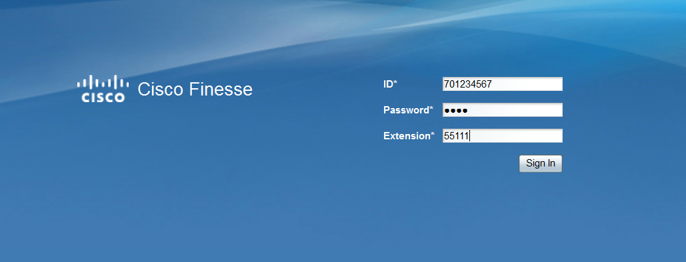
Finesse Agent Login
http://discvpfns01.ivr.arkgov.net
The User ID and password are case sensitive.
Log in with your User ID and Password
Use your 10 Digit Agent extension number

Slide 3
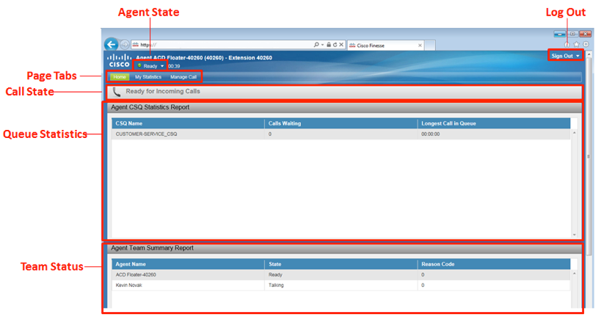
Finesse Agent desktop Overview
Notes:
After you sign in, you can change your status to Ready to make yourself available for calls. The buttons in the call control area change depending on the situation. For example, when you are on a call, Consult, Direct Transfer, Hold, Keypad, and End buttons are available. When you have a call on hold and are on a consult call, Conference, Transfer, Retrieve, and End buttons are available. When you are on a conference call, buttons for Hold, Consult, Direct Transfer, Keypad, and End are available.
The Finesse agent desktop provides the following out-of-the-box functionality:
Basic call control: Answer, hold, retrieve, end and make calls.
Advanced call control: Make a consultation call and transfer or conference the call after the consultation.
Agent state and call timers: The agent state timer indicates the length of time in Ready or Not Ready state. The call timer indicates total call time, hold time, and wrap-up time.
Single-step transfer: Transfer a call without the need to first initiate a consultation call.
Preview Outbound calls: Preview the customer information for the call before you choose to accept, reject, or close the contact.
Preview Outbound Personal Callback calls: After you preview a personal callback call, you can choose to accept or reject the contact.
Send DTMF digits: Send DTMF digits to interact with an IVR system.
Not Ready and Sign Out reason codes: Code to indicate why you are changing your status to Not Ready or signing out (your administrator defines these codes).
The Finesse agent desktop also provides a Queue Statistics gadget. The Queue Statistics gadget displays information about the queues to which you are assigned. You can click the column headers to sort information in ascending or descending order. The Queue Statistics gadget provides information about the following:
Queue Name: The name of the queue.
# Calls: The number of calls waiting in the queue.
Max Time: The length of time the oldest call has been in the queue.
Ready: The number of agents assigned to the queue who are in Ready state.
Not Ready: The number of agents assigned to the queue who are in Not Ready state.
Active
In: The number of agents assigned to the queue who are on inbound calls. ◦
Out: The number of agents assigned to the queue who are on outbound calls.
Other: The number of agents assigned to the queue who are on internal consult calls.

Slide 4
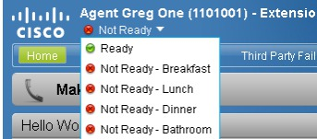
Finesse Agent state
The Agent State pull down tab enables you to change your current agent state.
Note: When you first log into the Agent desktop, you will be in a Not Ready state.
Notes:
After you sign in, you can change your status to Ready to make yourself available for calls. The buttons in the call control area change depending on the situation. For example, when you are on a call, Consult, Direct Transfer, Hold, Keypad, and End buttons are available. When you have a call on hold and are on a consult call, Conference, Transfer, Retrieve, and End buttons are available. When you are on a conference call, buttons for Hold, Consult, Direct Transfer, Keypad, and End are available.
The Finesse agent desktop provides the following out-of-the-box functionality:
Basic call control: Answer, hold, retrieve, end and make calls.
Advanced call control: Make a consultation call and transfer or conference the call after the consultation.
Agent state and call timers: The agent state timer indicates the length of time in Ready or Not Ready state. The call timer indicates total call time, hold time, and wrap-up time.
Single-step transfer: Transfer a call without the need to first initiate a consultation call.
Preview Outbound calls: Preview the customer information for the call before you choose to accept, reject, or close the contact.
Preview Outbound Personal Callback calls: After you preview a personal callback call, you can choose to accept or reject the contact.
Send DTMF digits: Send DTMF digits to interact with an IVR system.
Not Ready and Sign Out reason codes: Code to indicate why you are changing your status to Not Ready or signing out (your administrator defines these codes).
The Finesse agent desktop also provides a Queue Statistics gadget. The Queue Statistics gadget displays information about the queues to which you are assigned. You can click the column headers to sort information in ascending or descending order. The Queue Statistics gadget provides information about the following:
Queue Name: The name of the queue.
# Calls: The number of calls waiting in the queue.
Max Time: The length of time the oldest call has been in the queue.
Ready: The number of agents assigned to the queue who are in Ready state.
Not Ready: The number of agents assigned to the queue who are in Not Ready state.
Active
In: The number of agents assigned to the queue who are on inbound calls. ◦
Out: The number of agents assigned to the queue who are on outbound calls.
Other: The number of agents assigned to the queue who are on internal consult calls.

Slide 5
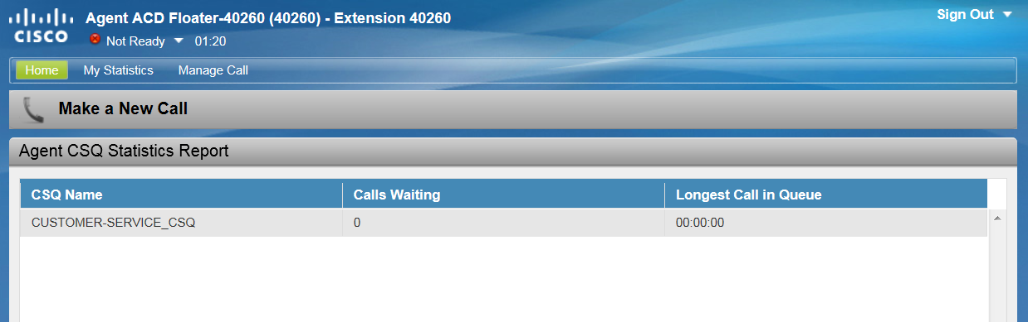
Finesse Agent Queue Status
Queue Statistic Report on Home tab gives agent count of people waiting in queue.
Shows longest time someone has been waiting in the queue
Notes:
After you sign in, you can change your status to Ready to make yourself available for calls. The buttons in the call control area change depending on the situation. For example, when you are on a call, Consult, Direct Transfer, Hold, Keypad, and End buttons are available. When you have a call on hold and are on a consult call, Conference, Transfer, Retrieve, and End buttons are available. When you are on a conference call, buttons for Hold, Consult, Direct Transfer, Keypad, and End are available.
The Finesse agent desktop provides the following out-of-the-box functionality:
Basic call control: Answer, hold, retrieve, end and make calls.
Advanced call control: Make a consultation call and transfer or conference the call after the consultation.
Agent state and call timers: The agent state timer indicates the length of time in Ready or Not Ready state. The call timer indicates total call time, hold time, and wrap-up time.
Single-step transfer: Transfer a call without the need to first initiate a consultation call.
Preview Outbound calls: Preview the customer information for the call before you choose to accept, reject, or close the contact.
Preview Outbound Personal Callback calls: After you preview a personal callback call, you can choose to accept or reject the contact.
Send DTMF digits: Send DTMF digits to interact with an IVR system.
Not Ready and Sign Out reason codes: Code to indicate why you are changing your status to Not Ready or signing out (your administrator defines these codes).
The Finesse agent desktop also provides a Queue Statistics gadget. The Queue Statistics gadget displays information about the queues to which you are assigned. You can click the column headers to sort information in ascending or descending order. The Queue Statistics gadget provides information about the following:
Queue Name: The name of the queue.
# Calls: The number of calls waiting in the queue.
Max Time: The length of time the oldest call has been in the queue.
Ready: The number of agents assigned to the queue who are in Ready state.
Not Ready: The number of agents assigned to the queue who are in Not Ready state.
Active
In: The number of agents assigned to the queue who are on inbound calls. ◦
Out: The number of agents assigned to the queue who are on outbound calls.
Other: The number of agents assigned to the queue who are on internal consult calls.

Slide 6
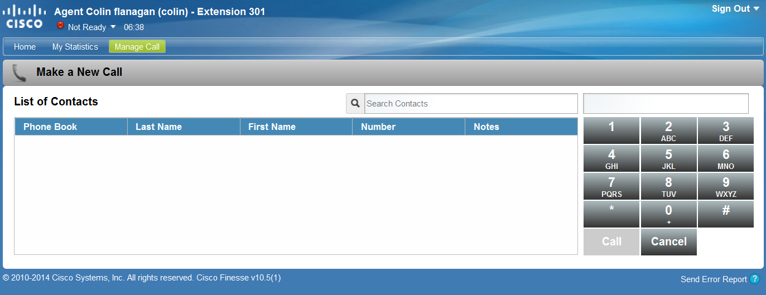
Finesse Agent Making a call
Agent must be in Not Ready,
  Select Make a New Call. A dial pad will appear. Dial using computer’s mouse to select the digits on Agent Desktop
            - or -
  Use the numbers keys on your keyboard

Slide 7
Finesse Agent Call Handling
  To Answer a call, click
  To End a call, click
  Placing a call on Hold, click
  To Retrieve a held call, click

Slide 8
Finesse Agent Transfer/Conference
  To transfer a call or create a conference call:
  Click
  Then dial the number to whom you wish to transfer the caller or add to your conference call.
  To complete the transfer, press
        - or -
  To conference all parties together,
  press

Slide 9
Finesse Agent End of work shift Sign out
To Sign Out of the Agent Desktop, you must put yourself in a Not Ready state.

Slide 10
Finesse
SUPERVISOR

Slide 11
Finesse Supervisor Login
http://discvpfns01.ivr.arkgov.net
The User ID and password are case sensitive.
Log in with your User ID and Password
Use your 10 Digit Agent extension number
Note: You will log in as an agent, but will have supervisor information as well. To make sure you don’t receive agent calls, keep yourself in the Not Ready state.

Slide 12
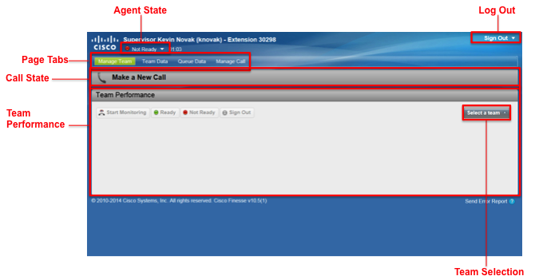
Finesse Supervisor desktop Overview

Slide 13
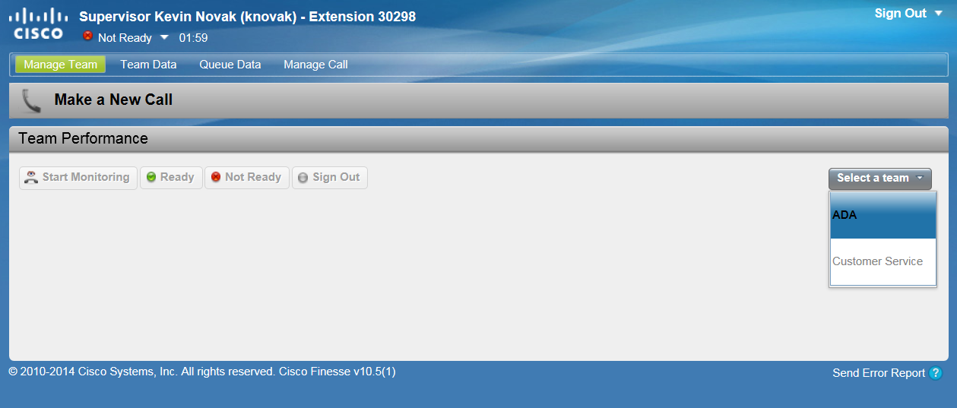
Finesse Supervisor Selecting Team
The Manage Team tab of the Supervisor Desktop allows you to select which team you will be monitoring.

Slide 14
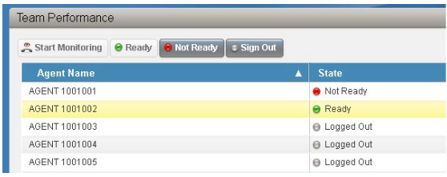
Finesse Supervisor Managing Teams
Changing Agent State:
In Team Performance Window, highlight agent who’s state you wish to change.
Press Ready, Not Ready or Sign out button.
Notes:
On the Team Performance gadget, you can select a team from a list of teams assigned to you. You can view the agents on that team, their current state, the time in state, and their extension. You can click the column headers to sort the information by Agent Name, State, Time in State, or Extension.
The Time in State field refreshes every 10 seconds. When an agent's state changes, the Finesse server sends out an agent state notification and the timer resets to 0. An agent state change includes changing from Not Ready with a reason code to Not Ready with a new reason code.
The Team Performance gadget also provides the following functionality:
Silent monitoring: Silently monitor an agent call.
Force state change: Force an agent into Ready or Not Ready state or sign out an agent.
When you silently monitor an agent, a Barge In button appears in the call control area. You can click this button to barge in to a call between the agent and customer. After you barge in, you can choose to intercept the call by dropping the agent.
The Queue Statistics gadget displays a list of the queues for which you are responsible. You can click the column headers to sort the information in ascending or descending order.
The Queue Statistics gadget provides the following columns:
Queue Name: The name of the queue
# Calls: The number of calls waiting in the queue
Max Time: The length of time the oldest call has been in the queue
Ready: The number of agents assigned to the queue who are in Ready state
Not Ready: The number of agents assigned to the queue who are in Not Ready state
Active
In: The number of agents assigned to the queue who are on inbound calls
Out: The number of agents assigned to the queue who are on outbound calls
Other: The number of agents assigned to the queue who are on internal consult calls

Slide 15
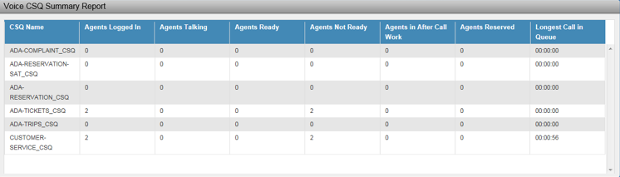
Finesse Supervisor CSQ Summary Report
  Calls Waiting – Number of calls waiting in a queue.
  Longest Call in Queue – Elapsed wait time of the oldest call in the queue.
Notes:
On the Team Performance gadget, you can select a team from a list of teams assigned to you. You can view the agents on that team, their current state, the time in state, and their extension. You can click the column headers to sort the information by Agent Name, State, Time in State, or Extension.
The Time in State field refreshes every 10 seconds. When an agent's state changes, the Finesse server sends out an agent state notification and the timer resets to 0. An agent state change includes changing from Not Ready with a reason code to Not Ready with a new reason code.
The Team Performance gadget also provides the following functionality:
Silent monitoring: Silently monitor an agent call.
Force state change: Force an agent into Ready or Not Ready state or sign out an agent.
When you silently monitor an agent, a Barge In button appears in the call control area. You can click this button to barge in to a call between the agent and customer. After you barge in, you can choose to intercept the call by dropping the agent.
The Queue Statistics gadget displays a list of the queues for which you are responsible. You can click the column headers to sort the information in ascending or descending order.
The Queue Statistics gadget provides the following columns:
Queue Name: The name of the queue
# Calls: The number of calls waiting in the queue
Max Time: The length of time the oldest call has been in the queue
Ready: The number of agents assigned to the queue who are in Ready state
Not Ready: The number of agents assigned to the queue who are in Not Ready state
Active
In: The number of agents assigned to the queue who are on inbound calls
Out: The number of agents assigned to the queue who are on outbound calls
Other: The number of agents assigned to the queue who are on internal consult calls

Slide 16
Finesse Supervisor CSQ Summary Report
  Calls Waiting – Number of calls waiting in a queue.
  Longest Call in Queue – Elapsed wait time of the oldest call in the queue.
Notes:
On the Team Performance gadget, you can select a team from a list of teams assigned to you. You can view the agents on that team, their current state, the time in state, and their extension. You can click the column headers to sort the information by Agent Name, State, Time in State, or Extension.
The Time in State field refreshes every 10 seconds. When an agent's state changes, the Finesse server sends out an agent state notification and the timer resets to 0. An agent state change includes changing from Not Ready with a reason code to Not Ready with a new reason code.
The Team Performance gadget also provides the following functionality:
Silent monitoring: Silently monitor an agent call.
Force state change: Force an agent into Ready or Not Ready state or sign out an agent.
When you silently monitor an agent, a Barge In button appears in the call control area. You can click this button to barge in to a call between the agent and customer. After you barge in, you can choose to intercept the call by dropping the agent.
The Queue Statistics gadget displays a list of the queues for which you are responsible. You can click the column headers to sort the information in ascending or descending order.
The Queue Statistics gadget provides the following columns:
Queue Name: The name of the queue
# Calls: The number of calls waiting in the queue
Max Time: The length of time the oldest call has been in the queue
Ready: The number of agents assigned to the queue who are in Ready state
Not Ready: The number of agents assigned to the queue who are in Not Ready state
Active
In: The number of agents assigned to the queue who are on inbound calls
Out: The number of agents assigned to the queue who are on outbound calls
Other: The number of agents assigned to the queue who are on internal consult calls

Slide 17
END

